Slide 1

INCOME CLASSIFICATION
Team Name: PySUM
. Group Members .
Shatmanyu Gupta
Udit Gupta
Shivam yadav

Slide 2
PROBLEM STATEMENT
CLASSIFY THE INCOME OF REGION INTO GROUPS OF PEOPLE EARNING ABOVE 50K AND BELOW 50K.

Slide 3
CONTENTS
DATASET DESCRIPTION
DATA PREPROCESSING
DATA VISUALISATION
Building Machine Learning Model

Slide 4
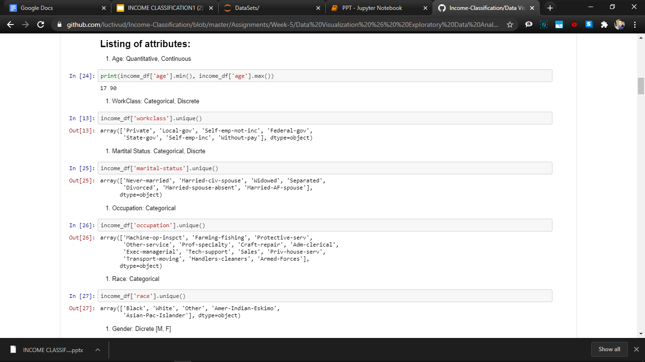
ATTRIBUTES
Age: Quantitative, Continuous : The age of the person.
WorkClass: Categorical, Discrete : defines the working class of the person.
Marital Status: Categorical, Discrete : Married or not.
Occupation: Categorical : The occupation of a person.
Race: Categorical

Slide 5
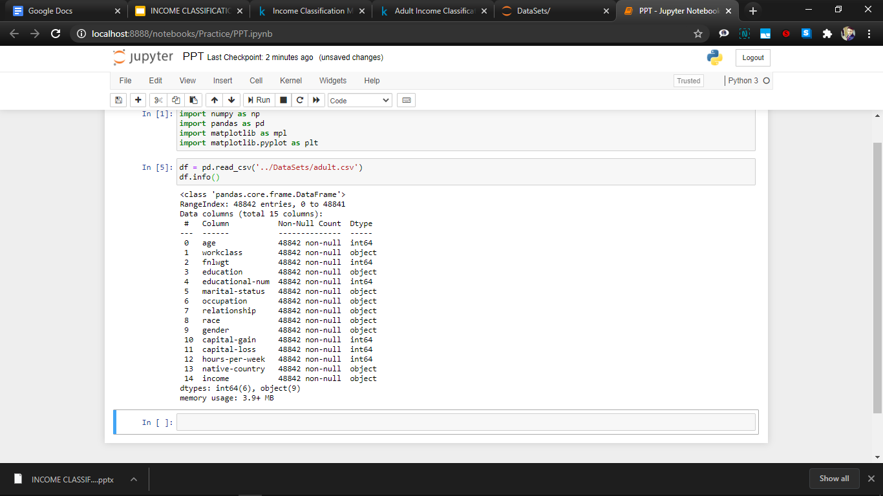
DATASET DESCRIPTION
The income dataset is taken from kaggle website and is expected to be extracted from 1994 U.S. Census database.
Size ~ 4 MB
(48842 x 15)

Slide 6
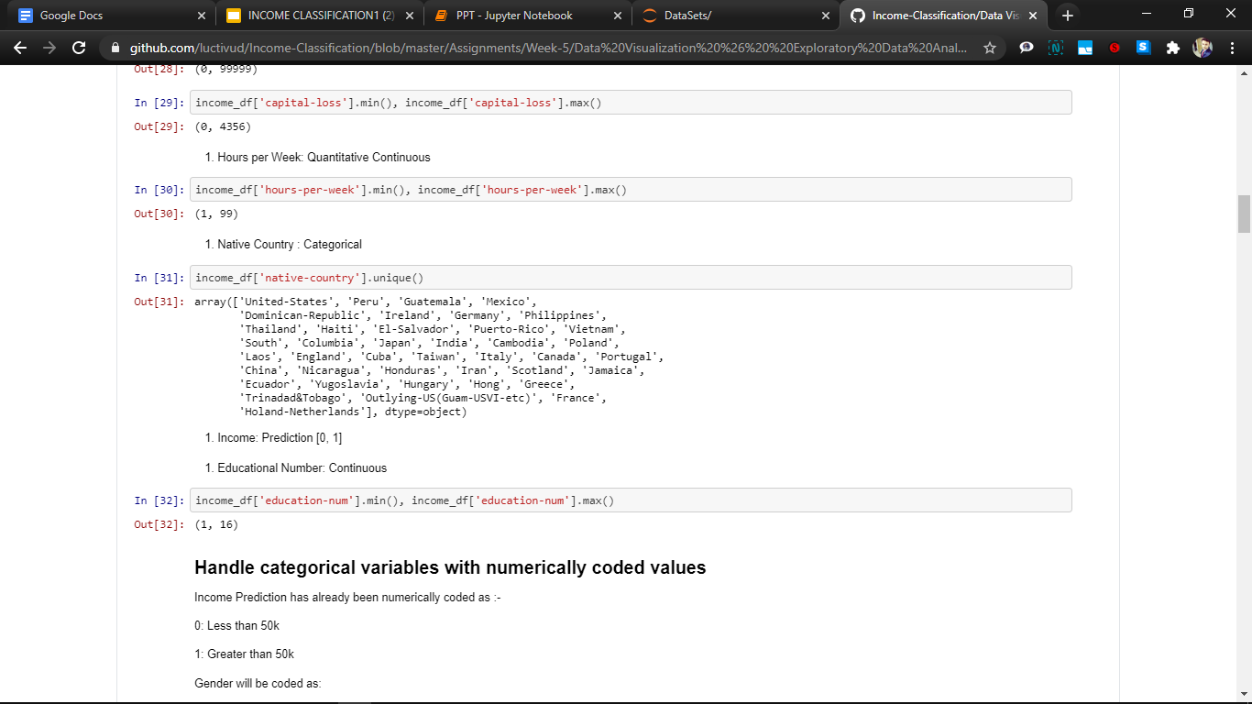
Education & Education Number: The highest level of education of a person and it’s depiction as an integer.
Relationship: The relationship of a person in the family.
Gender: Sex of the person.
fnlwgt: In other words, finalwgt this is the no.of people the census believes the entry represents.
Native Country: The native Country of a person
Capital Gain and Loss : The net capital gain or loss acc to the person from the previous year.
Hours per Week: The net hours a person works in a week.

Slide 7
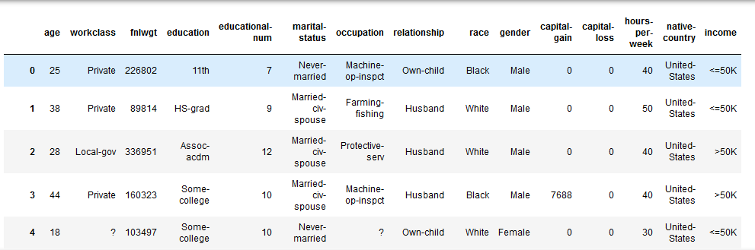
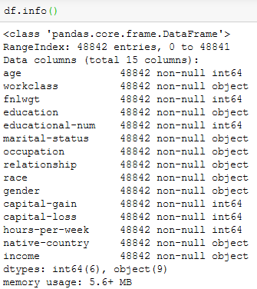
Data Preprocessing
Loading the data.
Describing the data.
Removing insignificant columns.
Checking and Removing missing values.
Formatting Data.

Slide 8
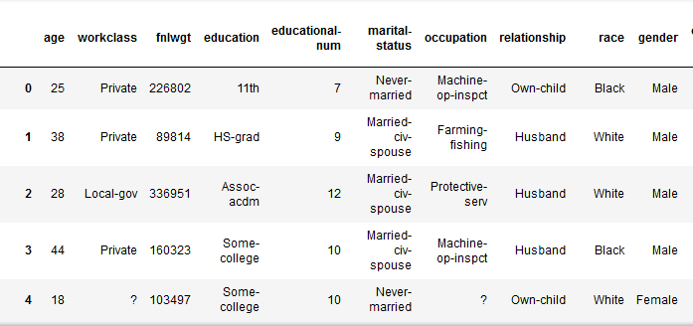
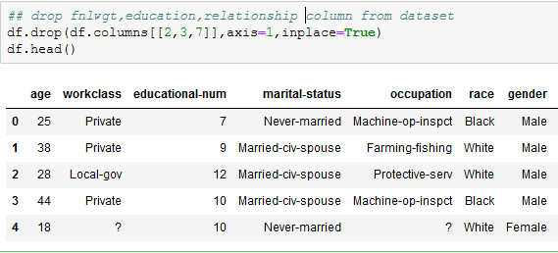
Removing Insignificant Columns
Removing attributes form dataset which don’t affect our learning model:
Finalwgt , Education, relationship .
These attributes not useful for our analysis , had too much bad data(outliers) or zero/null values which leads to non-uniformity of data.

Slide 9
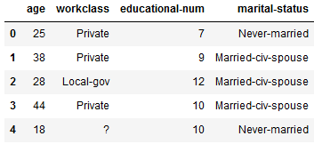
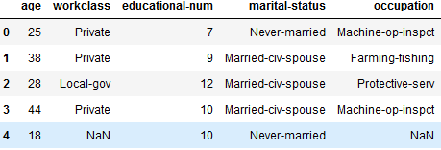

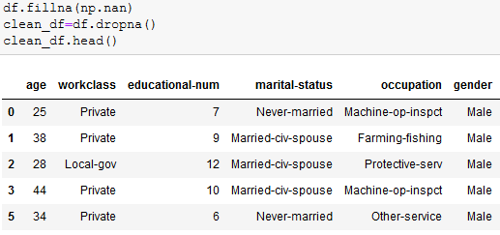
Checking and Removing missing values
Firstly Replacing “?” values to NaN with the help of np.nan
Dropping all rows containing nan values using dropna() function of numpy.
3620 rows removed

Slide 10
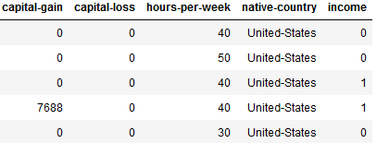
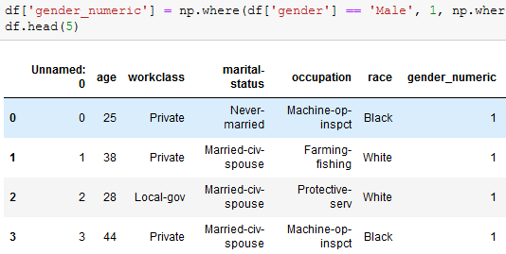
Formatting datatypes
Encoding categorial values to visualize the data efficiently and to make datatypes compatible with each other
ex:- Encoding income using np.where() as -
<=50k =0
>50k =1
Encoding gender->gender_numeric
Male = 1
Female = 0

Slide 11
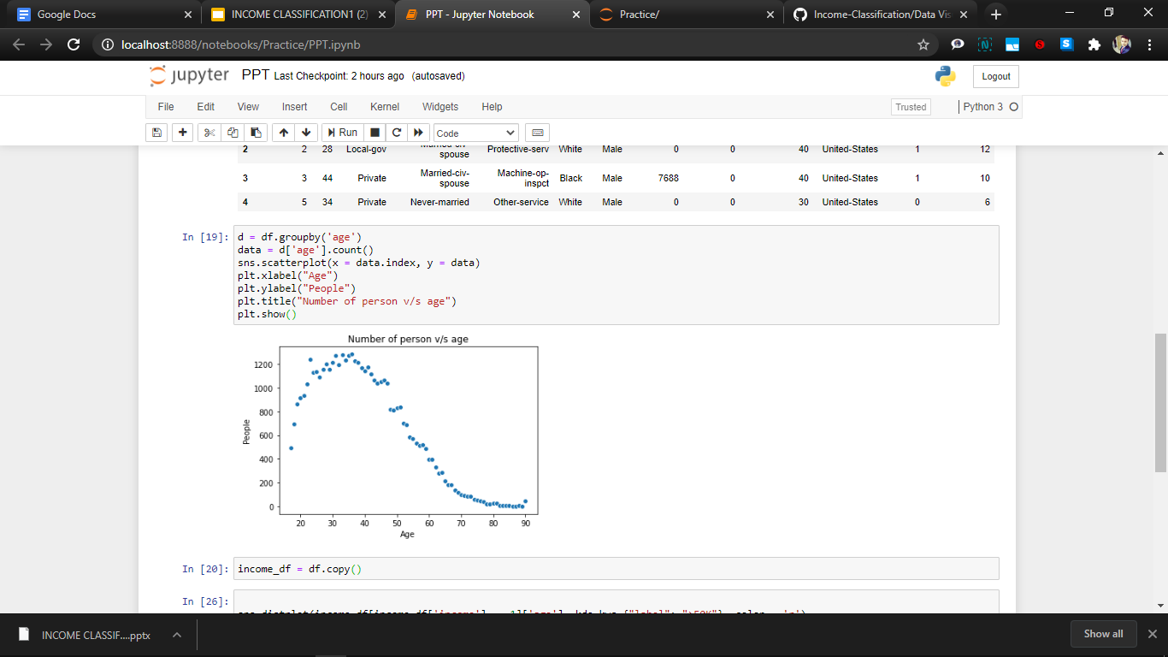
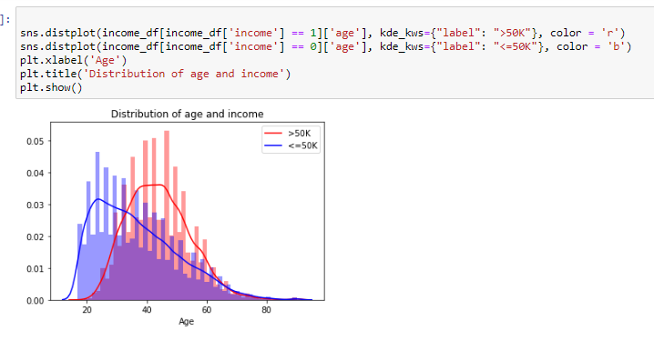
DATA VISUALISATION
Age:
The plot shows that maximum people who have an income >50k belong to the age group 40 to 50 years.
Another thing to note is that people tend to have a lower income in early age but then gradually increase their income to above 50k in around 45 years of age.
The upper limit of age is 90 years and the lower limit is 17 years.
The dataset contains maximum people in the age group 25- 40 years.

Slide 12
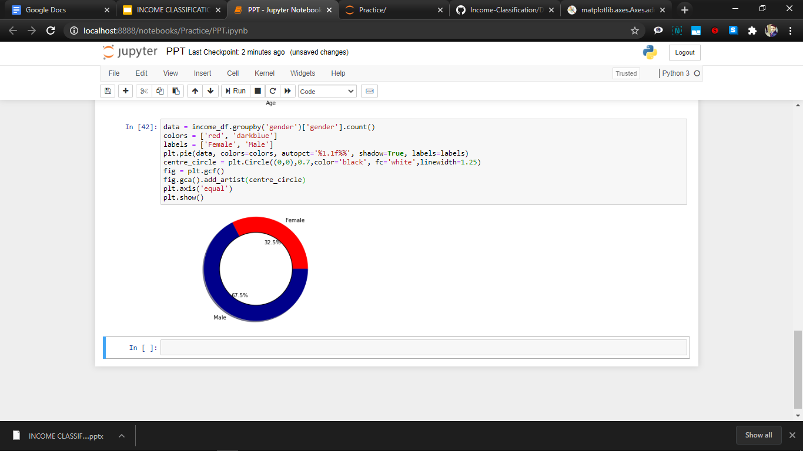
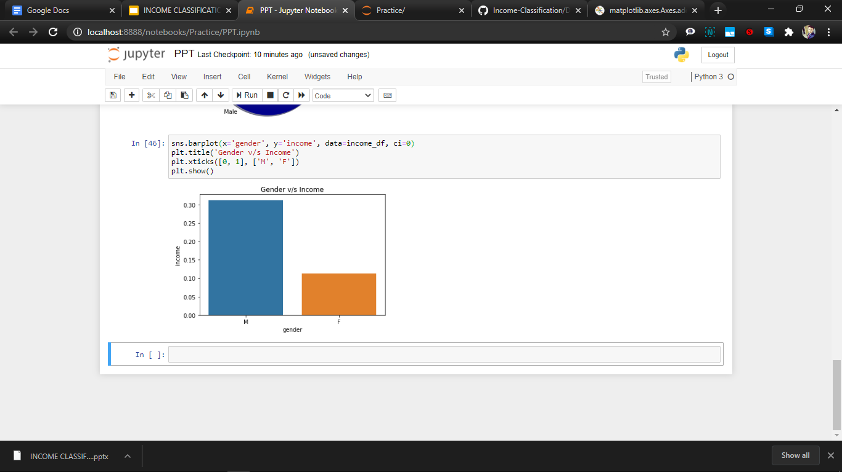
Gender:
The above donut chart shows that the total male entries is more than double of the total female entries in our dataset.
The percentage of male who earn above 50k is double than that of women.

Slide 13
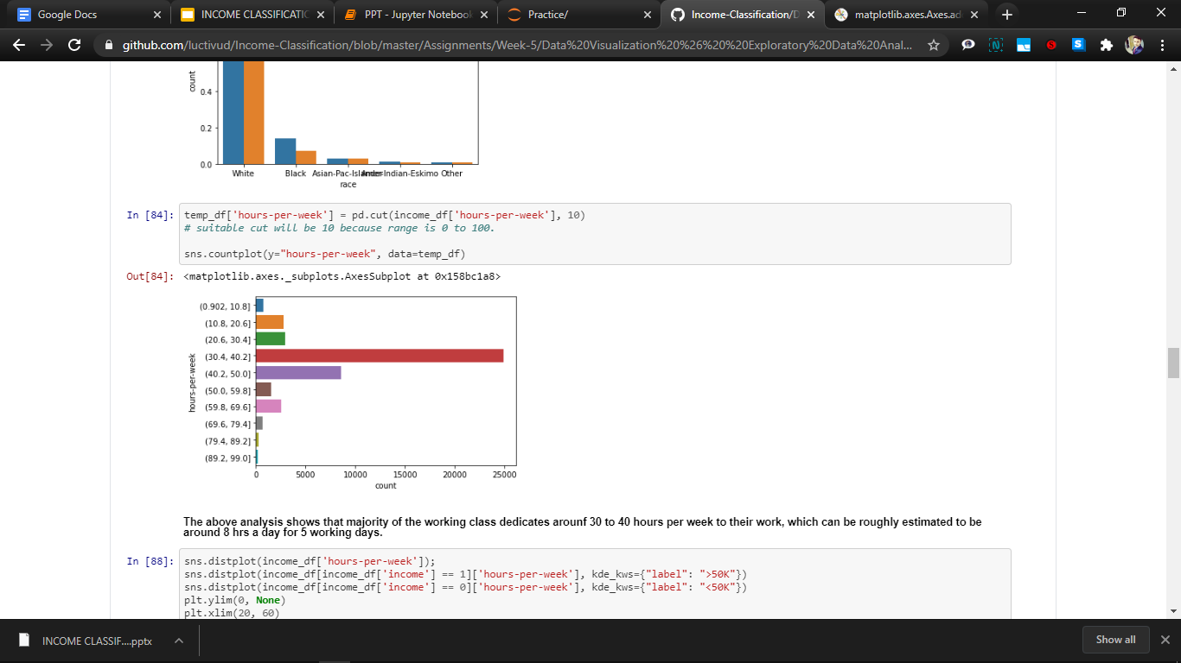
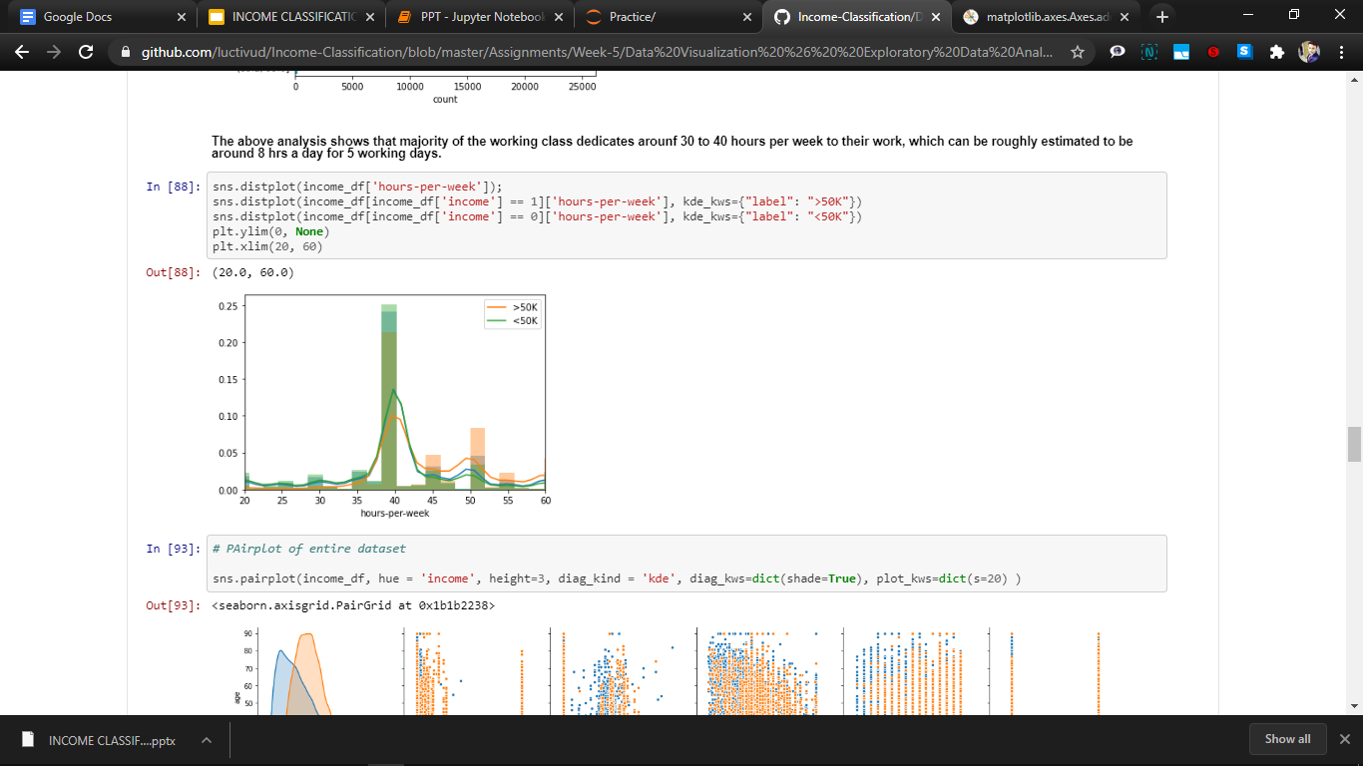
Hour per week:
The majority class works for 40 hours in a week which is around 8 hours for a working day.
There is a certain outlining value of 90 hours a week.
The maximal and optimal hours of working is hence 35 to 45 hours in the dataset giving out maximum high earners.

Slide 14
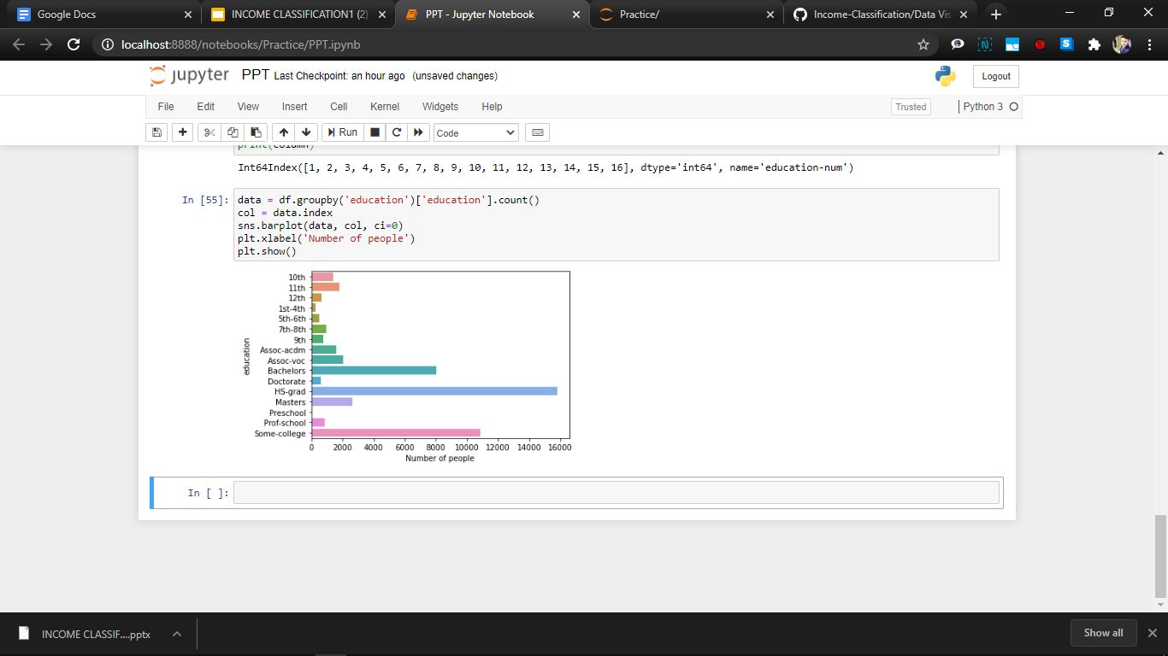
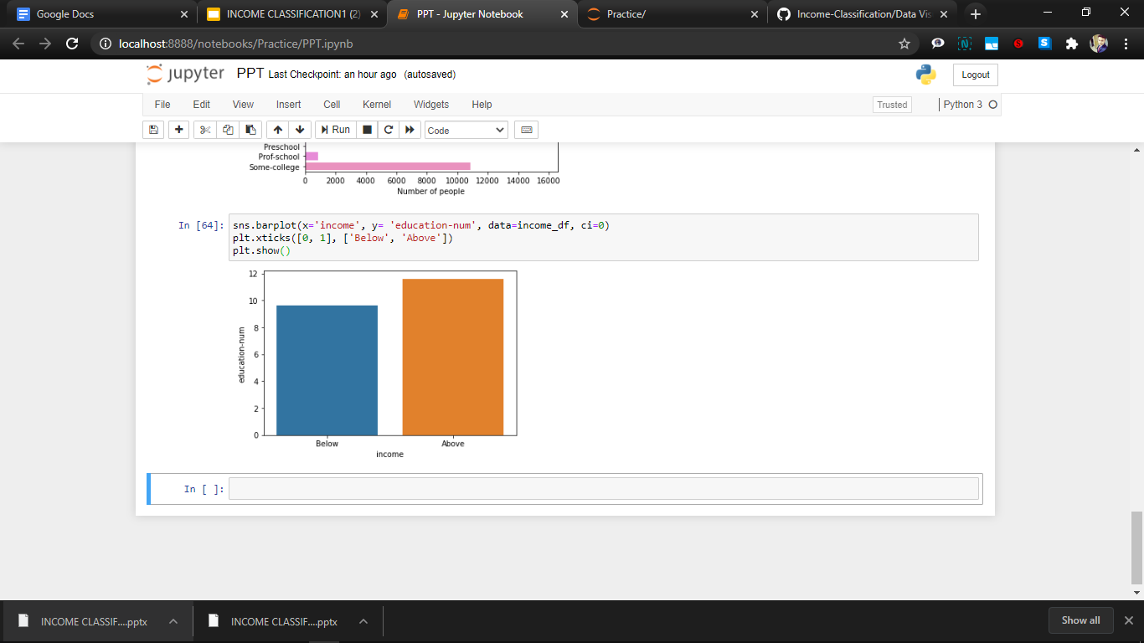
Education:
Majority of people have passed high school in the dataset or have a degree preferably Bachelors from some college.
This shows that if a person crosses high school and opt for a diploma or degree from a college, they have a better chance of getting higher income.
Avg education num :
Below - 10, Above - 12

Slide 15
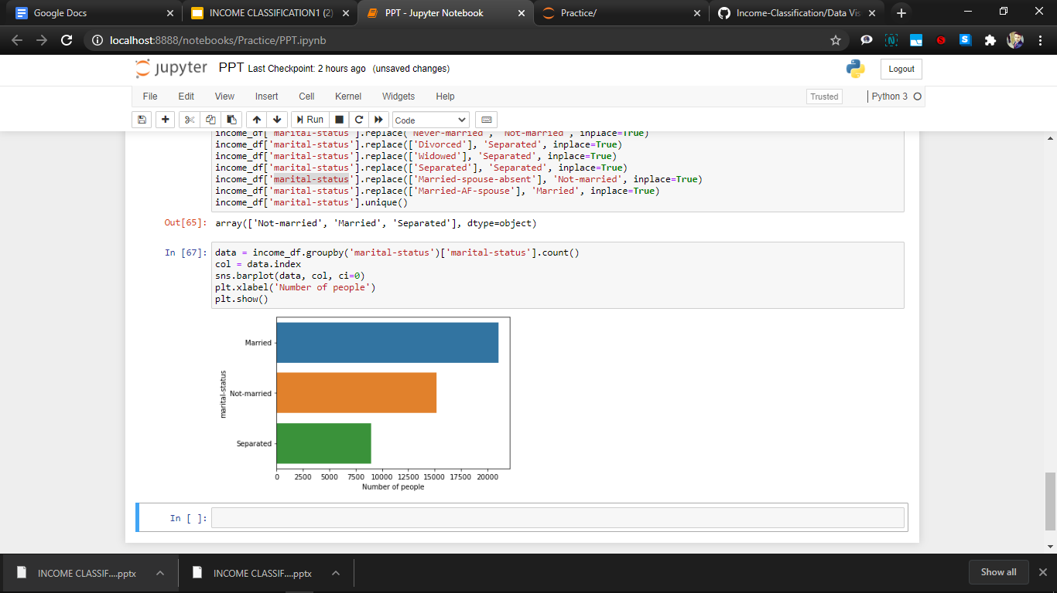
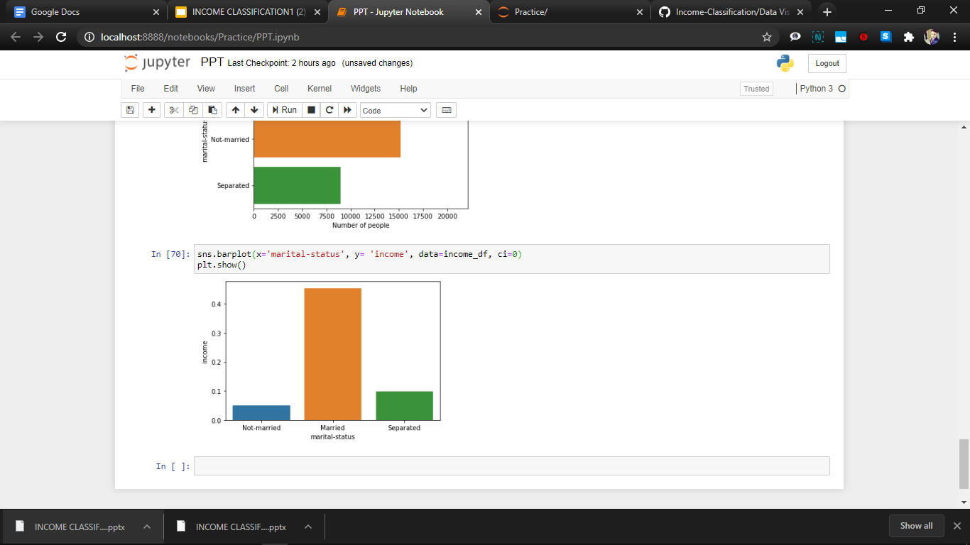
Marital Status:
The dataset has weightage of married and unmarried people in the society, with less than half of their cumulative sum of people being seperated.
Although the unmarried ones holds a majority in the population but still they don’t earn as much as the other groups, dominated by the married people.

Slide 16
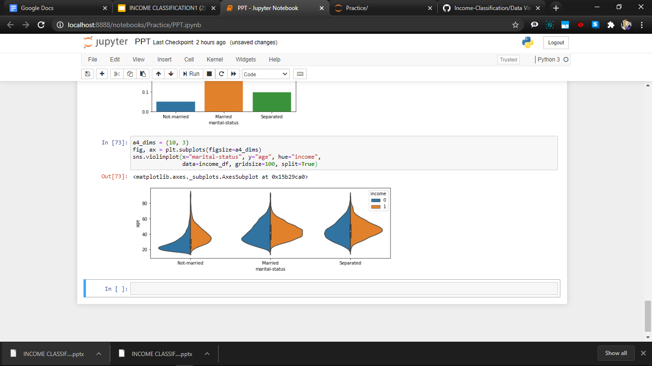
Marital Status vs Age
This shows that married as well as separated share the same relation in age.
Why unmarried earn less despite constituting a majority?
As shown by the plot, it is quite clear that the unmarried people are around the age of 20-40.
And due to our previous analysis it is shown that optimal age for big earning is above 40 years, and after that age almost everyone is married, hence unmarried tends to earn less by virtue of their age group.

Slide 17
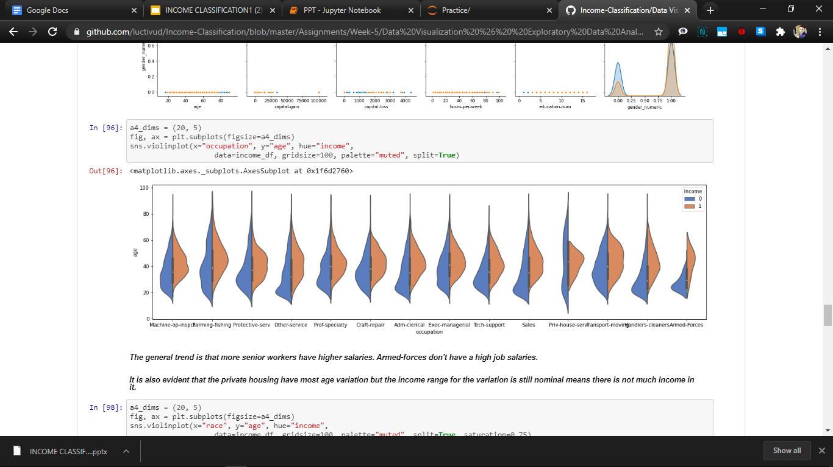
Occupation v/s Age:
Plot the Occupation vs Age graph on the basis of the income as base line.
The general trend is that more senior workers have higher salaries.
Armed-forces don't have a high job salaries.
It is also evident that the private housing have most age variation but the income range for the variation is still nominal means there is not much income in it.

Slide 18
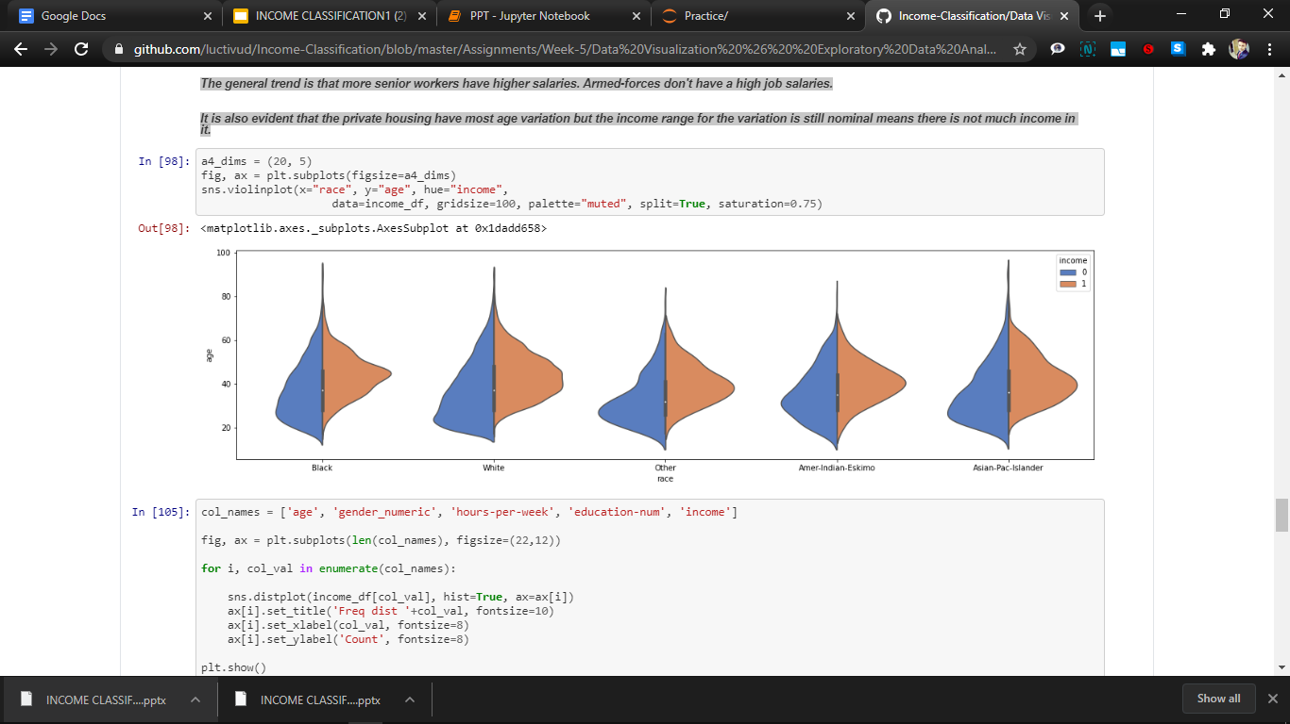
Race v/s Age over Income
It is seen from the above violin plot that the income distribution does rarely depend on the race of a person as the distribution as well width of the plot is identical in every aspect.
Although there is a certain decrease in the income of above 50k for black people and the american-indians have a uniformly scattered plot against age for above 50k.

Slide 19
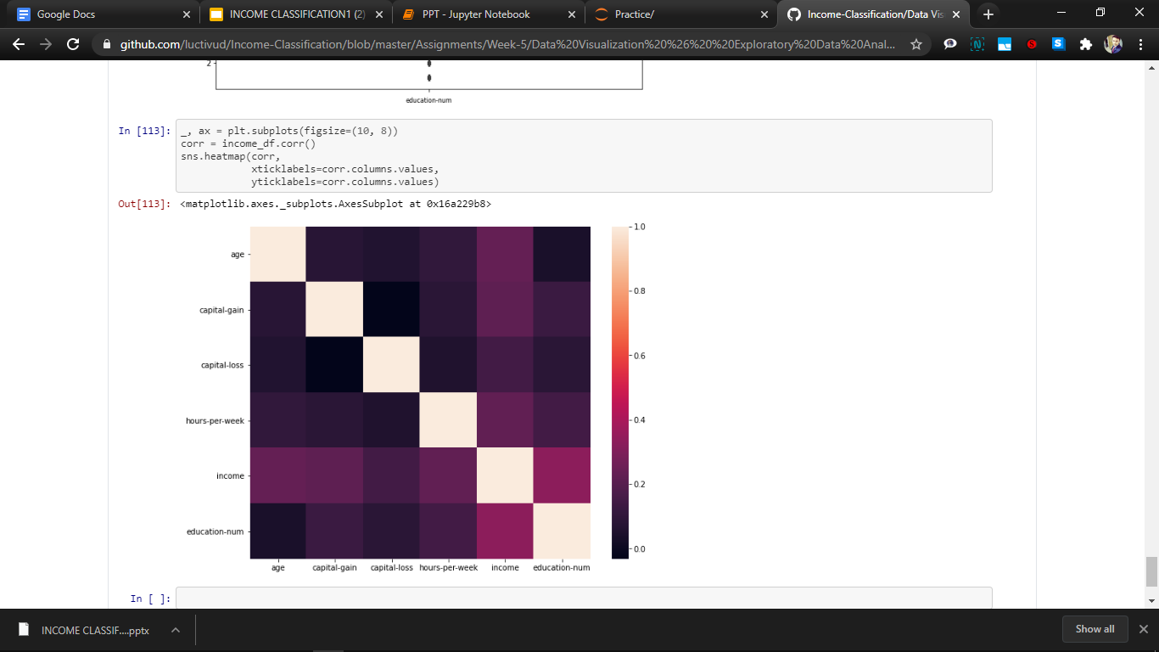
Correlation Matrix
It is evident that the two most important factors for determining the income of a person are the age and education number.
Capital gain and loss also foresee the same as the person with higher gain can hit 50k early.
Hours per week also defines it with its optimal range of working hours & impacting the income distribution.

Slide 20

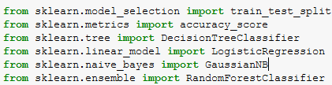

Building Machine Learning Model
Seperating training and testing data
Applying different methods to get the best results.
Analysis

Slide 21
Seperating test and train data
1. We save our formatted(Clean) dataset in variable x as independent variable and income attribute in y variable as dependent variable.
2. We separate training and testing data for our model as :
Training : 80%
Testing : 20%
with the help of train_test_split module of
model_selection library of sklearn package.
x_train->training x , y_train->training y, x_test->testing x , y_test->testing y

Slide 22

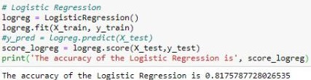
Applying Machine Learning Methods
1. Importing different machine learning
modules like :
Naive Bayes
Logistic Regression
Random Forest Classifier
K different Neighbours
2. Fitting the data in the training set and checking
the accuracy score of each method .

Slide 23
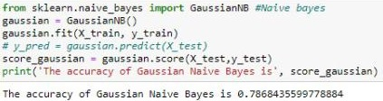
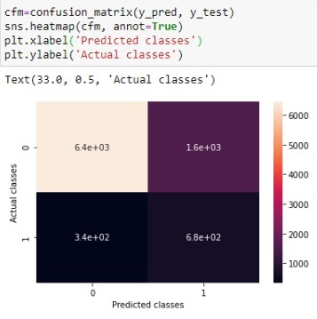
Naïve Bayes
1. Naive Bayes methods are a set of
supervised learning algorithms based on
applying Bayes’ theorem with the “naive”
assumption of conditional independence.
between every pair of features given the
value of the class variable.
2. It requieres small amount of trainig data
to estimate test data so training period
is less .
3. It is famously used in spam filtering
and document classification.

Slide 24
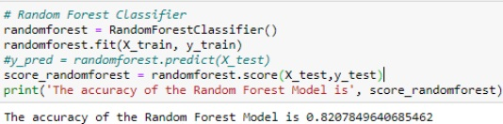
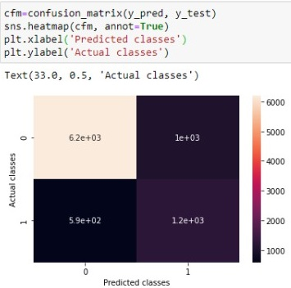
Random Forest
1. Random forests or random decision forests are an ensemble learning method for classification, regression and other tasks that operate by constructing a multitude of decision trees at training time and outputting the class that is the mode of the classes (classification) or mean prediction (regression) of the individual trees.
2. it is used because it is used for both classification and regression tasks.
3. The random forest algorithm has its application in different sectors including Banking, Medicine, Stock Market and E-commerce.

Slide 25
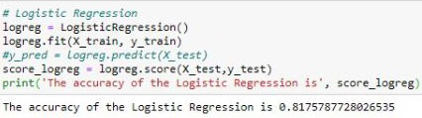
Logistic Regression
1. Logistic regression is a classification algorithm used to assign observations to a discrete set of classes. Some of the examples of classification problems are Email spam or not spam.
2. Logistic Regression performs well when the dataset is linearly separable.
3. It has variety of applications in machine learning , medical sciences and social sciences.

Slide 26
Analysis
Confusion Matrix:
confusion matrix is a summary of prediction results on a
classification problem.
The number of correct and incorrect predictions are summarized with count values and broken down by each class.
This is the key to the confusion matrix. It gives us insight not only into the errors being made by a classifier but more importantly the types of errors that are being made.

Slide 27
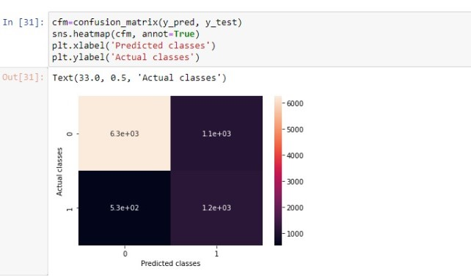
Analysis
in x axis 0 denotes “Less than or equal 50K” and 1 denotes “Greater than 50k”. This confusion matrix is made by using a random forest model. Class 0 is predicted correctly 6.3e+03 times and class 1 is predicted correctly 1.2e+03 times.
we can make another conclusion that class 0 means people whose income is less than or equal to 50k are more than class 1 i.e. people whose income is greater than 50k.

Slide 28
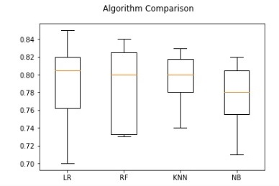
Algorithm Comparison
From the above analysis,it suggests that both Random Forest and KNN algorithms are perhaps worthy of further study on this problem.

Slide 29
Conclusion
Only about 1/3 of the population at the time would be considered high income while 2/3 of the population was making less than 50,000 USD per year.
The male working market more than doubled the female working market in 1994.
Married people had the highest percentage of high income people with husbands making up the majority of the workforce.
Random Forest gives best classification accuracy in income classification.

Slide 30
Thank You!

